Slide 1

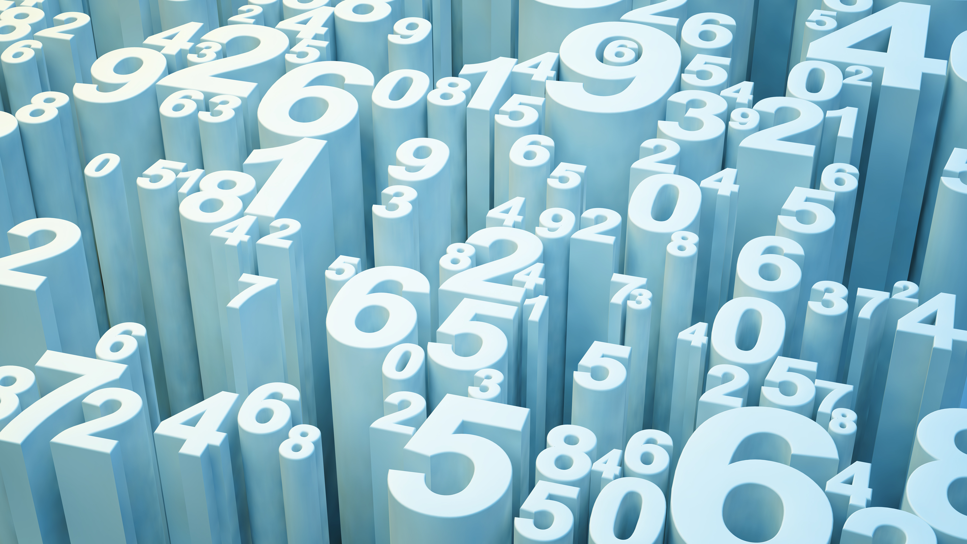
Intelligent traffic optimization using gen AI
GPTaboos
Build with GenAI hackathon

Slide 2

Problem statement
Problem Statement: Predict traffic congestion in urban Indian cities and propose solutions for
smoother transportation.
AI models can be used to predict the future trends in traffic based on past data at particular locations

Slide 3
Possible Solution
One of the possible solutions would be to increase the frequency of buses and urban transit during peak hours along the most congested routes.
Building flyovers at intersections rather than having signals can also reduce the traffic congestion as vehicles do not have to stop and wait to pass.
AI Models can predict the points and times of the worst congestions, and give recommendations on where it would be optimal to implement the above solutions.

Slide 4
Problem Solution
The model could be trained on traffic data from cities like number of vehicles passing through junctions. This model could then find the times of peak traffic at the various locations, and find which locations have the worst problems, and at which times
This would help pinpoint which areas need the most attention for increasing public transit and making flyovers.

Slide 5
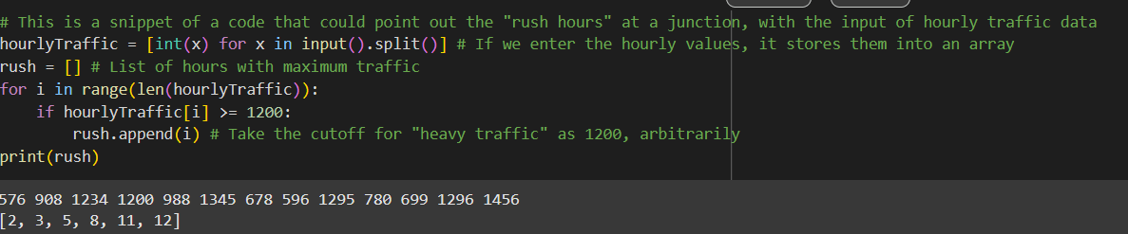
Problem Solution
This code snippet can give the times of heaviest traffic for one junction. The same can be repeated for other locations and the ones with the longest times of high traffic can be considered for the solution

Slide 6
Conclusion
This presents an idea where AI technology can be incorporated to find solutions to problems in cities, especially traffic problems.
By extensively using this combined with IoT(which is beyond the scope of this project) traffic problems can be partially or fully mitigated.

